Slide 1
MICRO-CREDIT
DEFAULTER
FlipRobo
Author : Chandan Kumar

Slide 2
INTRODUCTION
A Microfinance Institution (MFI) is an organization that offers financial services to low income populations. MFS becomes very useful when targeting especially the unbanked poor families living in remote areas with not much sources of income. The Microfinance services (MFS) provided by MFI are Group Loans, Agricultural Loans, Individual Business Loans and so on.
Many microfinance institutions (MFI), experts and donors are supporting the idea of using mobile financial services (MFS) which they feel are more convenient and efficient, and cost saving, than the traditional high-touch model used since long for the purpose of delivering microfinance services. Though, the MFI industry is primarily focusing on low income families and are very useful in such areas, the implementation of MFS has been uneven with both significant challenges and successes.
Today, microfinance is widely accepted as a poverty-reduction tool, representing $70 billion in outstanding loans and a global outreach of 200 million clients.

Slide 3
What is Micro Credit?
Microcredit is an extremely small loan given to those who lack a steady source of income, collateral. It is used as a way to obtain a loan, acting as a protection against potential loss for the lender should the borrower default in his payments., or any credit history.

Slide 4
Problem Statement
Telecom provider provide micro-credit on mobile balances to be paid back in 5 days.
Loan Varity :
Loan amount of 5 - Payback amount 6 (in Indonesian Rupiah)
Loan amount of 10 - Payback amount 12 (in Indonesian Rupiah)
Task is Build ML classification Model to Predict customer who might be defaulter based on independent features.

Slide 5
DATASET INFORMATION
Dataset provide by Fliprobo Technologies Ltd.
Micro Credit Defaulter dataset contain 209593 rows and 37 columns.
Out of all features only three features with object datatypes and rest are int64.
Data integrity check is perform for missing values, duplicate data, data error.
No missing values, whitespaces, ‘NA’, ‘-’ are present in dataset.
Data error and correction in maxamnt_loans30 column
The maximum value in maxamnt_loans30 is not reliable.
Assumption - The maximum value in maxamnt_loans30 is 12.
Corrective Action - Replacing values greater than 12 into category of zero.
Dropping Unnecessary columns

Slide 6
Perform Proper Data Cleaning
At First we import all Libraries which may need in our project and with that we also read our CSV file.
Now here we will look in to data for null values and some duplicate columns if present.
After checking for null value which are not present in datavwe will look for Description or Statistical summary of our whole data.
We will also look for data types of the all attributes and we will change those by using Label Encoder for future use.
Now we will look for correlation summary and heat map , it will provide us good knowledge of correlation among given data.
We can see that there are outliers in data but we can not delete those data because if we run that process we will lose very ig amount of data.

Slide 7
DATA VISUALISATION
We are using histPlot for better understanding of all attributes present in the Dataset.
We also look for skewness with the help of DistPlot and we can see that data is skewed.
We can also look for Label counts in data where we can see in visualisation ‘1’ is on higher side.
We are also looking to another few columns in visualisation with the help of plot and those columns are plays major part in this dataset.

Slide 8
MODELS
We are using here few models like LogisticRegression(),
GaussianNB(),DecisionTreeClassifier(),KneighborsClassifier(),SVC(),RandomForestClassifier().
But before that we split data into source(X) and target (Y).
Now we now that our data is classification base where value 1 and 0 are exist, thats why we will use here Confusion Matrix, Classification Report, Accuracy Score.
We use here few hypeparameter with our models.
We also see the AUC score and also plot the AUC_ROC curve for our final model.

Slide 9
MACHINE LEARNING MODEL BUILDING
Objective is to predict customer is defaulter or not. It can be solve by application of classification ML algorithm.
Different Classification algorithm used to train model, in order to have maximum accuracy score.
Machine learning classification algorithms used in this project are –
Logistics Regression
2. Decision Tree Classifier
3. Random Forest Classifier
GaussianNB
SVC
6. KNeighborsClassifier

Slide 10
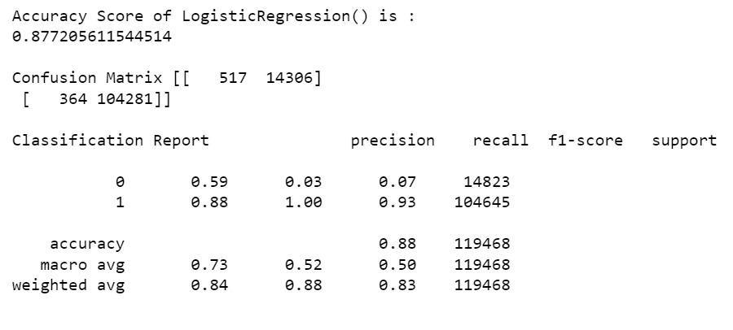
ML MODEL Evaluation Matrix

Slide 11
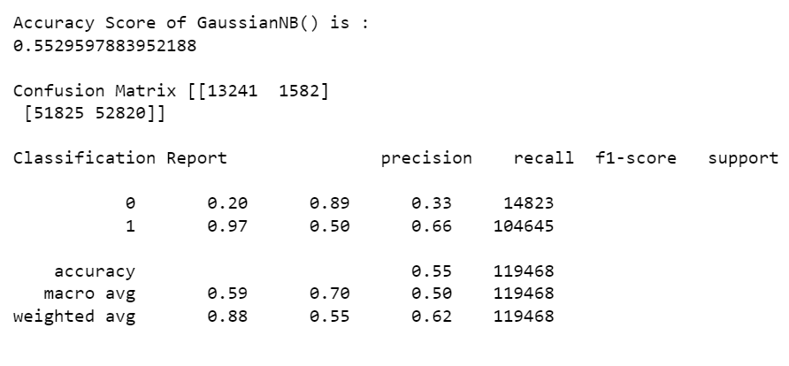
ML MODEL Evaluation Matrix

Slide 12
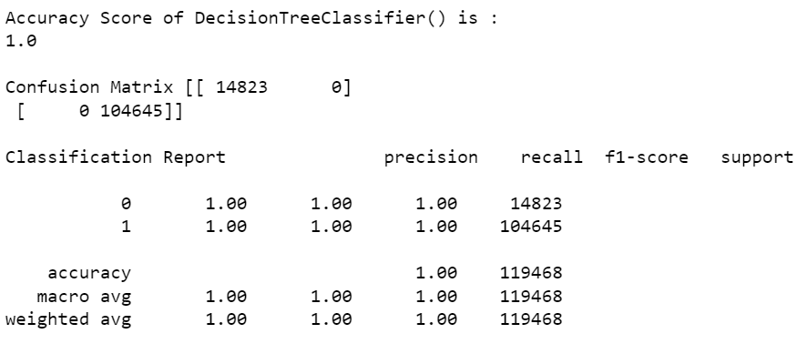
ML MODEL Evaluation Matrix

Slide 13
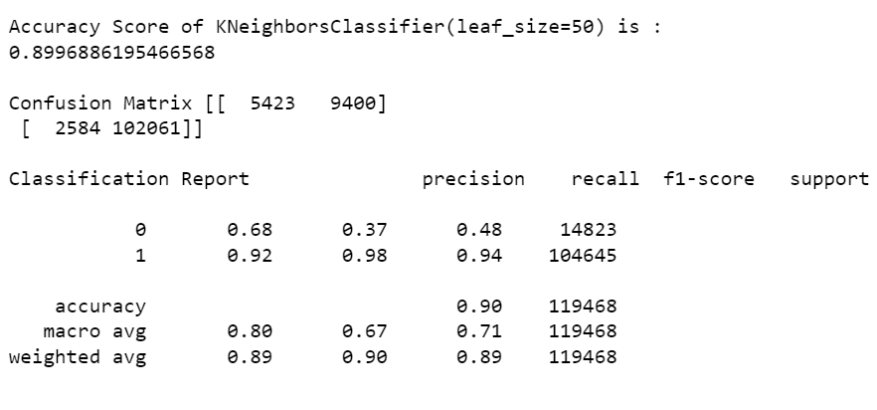
ML MODEL Evaluation Matrix

Slide 14
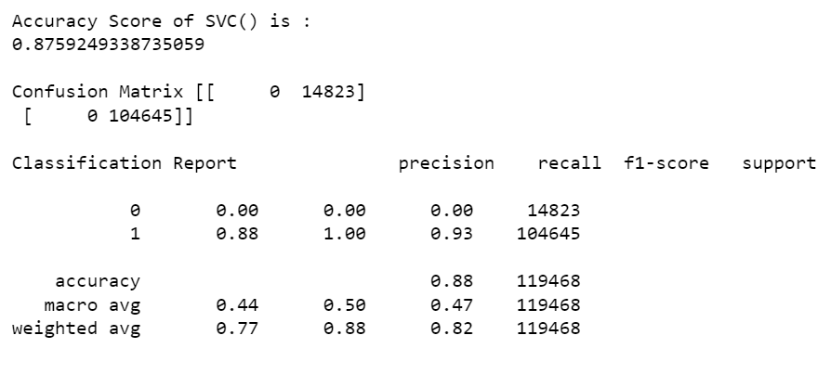
ML MODEL Evaluation Matrix

Slide 15
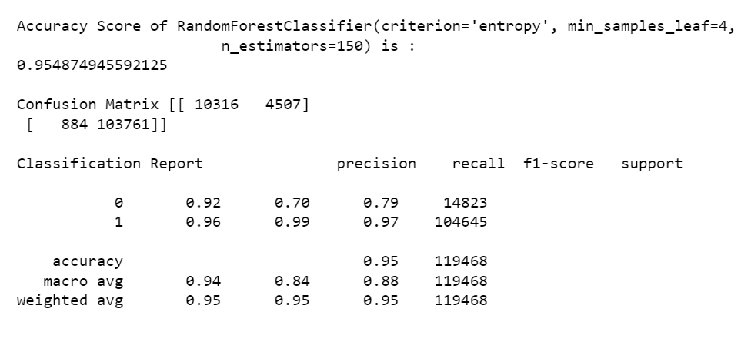
ML MODEL Evaluation Matrix

Slide 16
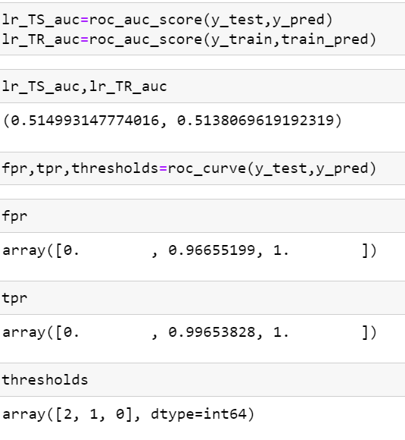
AUC-ROC SCORE

Slide 17
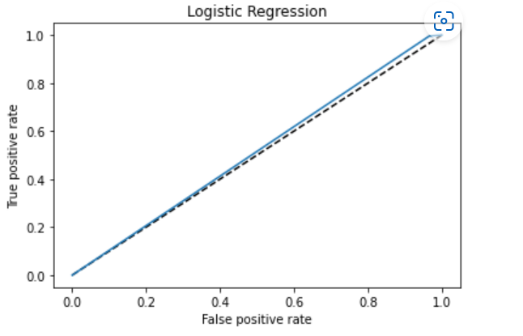
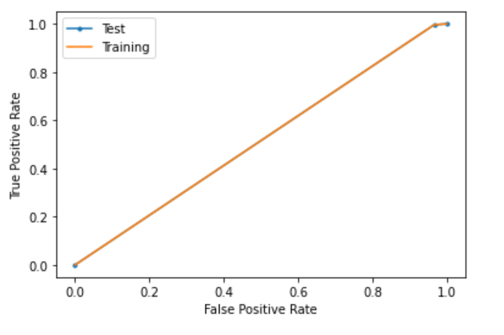
AUC-ROC SCORE

Slide 18
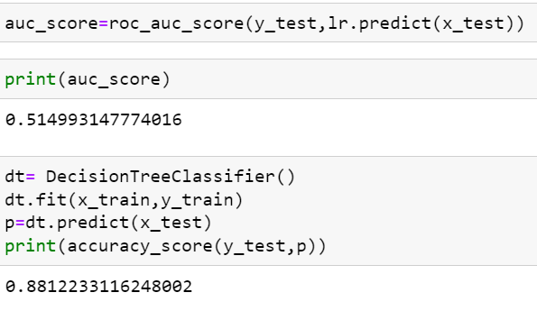
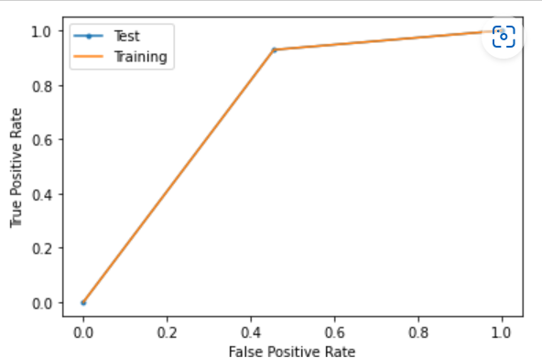
AUC-ROC SCORE

Slide 19
Limitations & Scope for Future OF THIS Work
Limited computational resources put limitation on optimization through hyper parameter tuning. Accuracy of model can increase with hyper parameter tuning with several different parameter. Here we use only two parameters for tuning.

Slide 20
Conclusion
We make a machine learning model in order to improve the selection of customers for the credit.
The client wants some predictions that could help them in further investment and improvement in selection of customers and our ML model helps them.
THANK YOU

